Slide 1
EIGEN VALUE AND EIGEN VECTOR
NAZMUL KADER CHOWDHURY

Slide 2
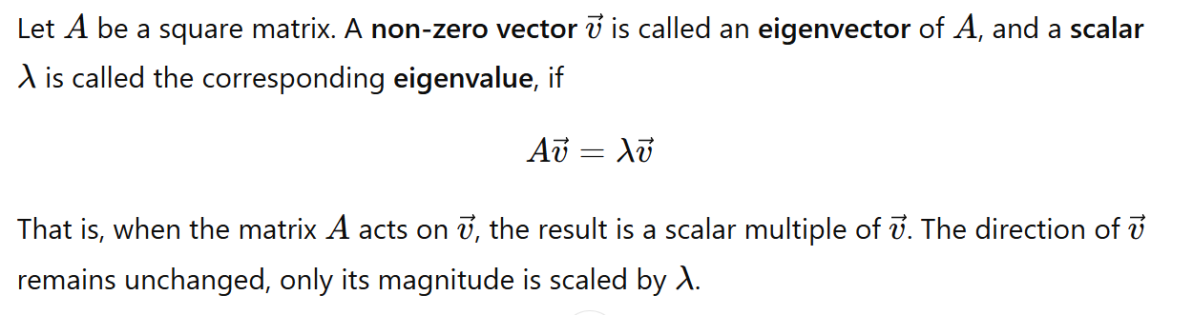
What is EIGEN Value and EIGEN Vector?

Slide 3
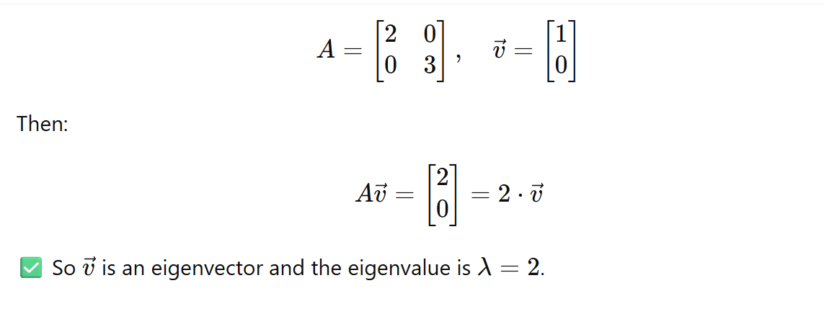

Slide 4
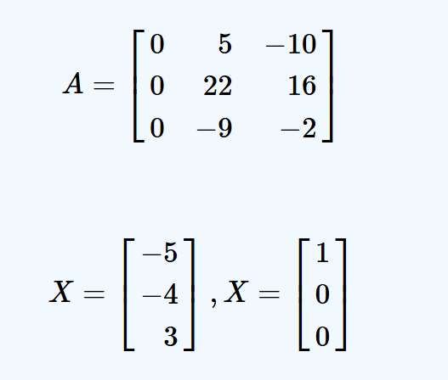

Slide 5
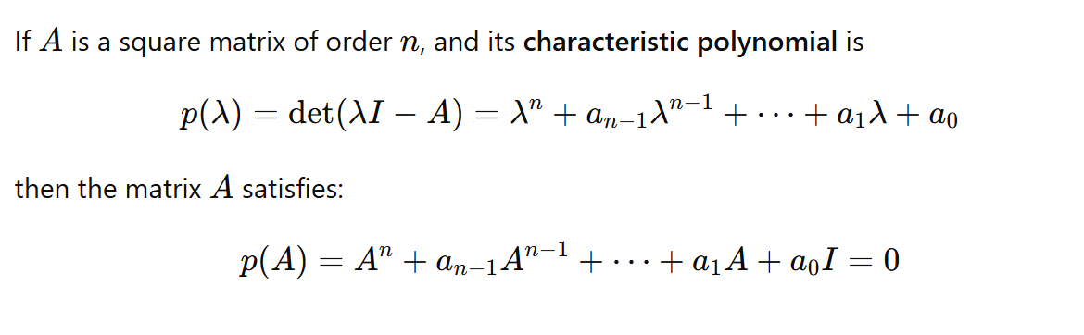

Slide 6
Problem

